Slide 1

Ruiqing LYU, Jeke CHEN, Yuwen WU, Hanwen FENG

Slide 2
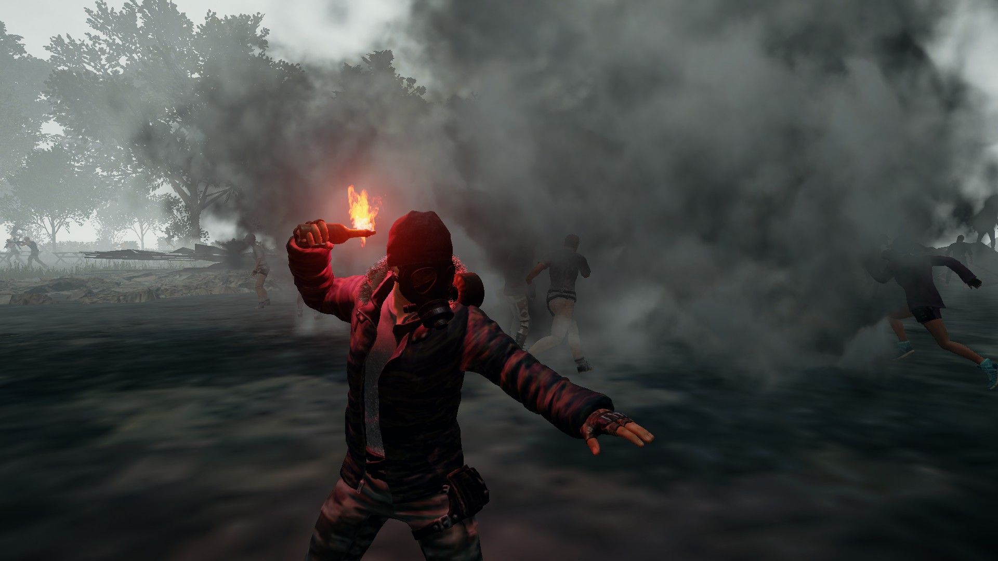
Notes:
Hanwen
PUBG is an online Battle-Royale style game
The game consists of a hundred players being airdropped into an island to fight to the death
PUBG earns revenue through micro-transactions for “loot boxes” that contain cosmetic items for your character
At its peak in January 2018, PUBG had a maximum of 3.2million users, but they currently only have around 900,000 users

Slide 3
Problem Statement
The video game industry is highly competitive
There have been many new alternate Battle-Royale games that compete with PUBG i.e. Fortnite, BlackOps 4, H1Z1
PUBG has seen a significant decrease in their user base since their peak
Can we identify PUBG’s failures through analyzing patch reviews and usage statistics?
Notes:
Problem Statement Jeke
Being one of the first games to deploy this battle-royale system, they easily amassed a large following very early on. On the one hand, as the battle royale genre got more popular, more games have emerged to compete with PUBG. On the other hand, the alterations and activities the developers released affected the users experience. The number of users keep decreasing under this condition. Our client will be the developers of PUBG, Bluehole inc. We will be helping them figure out the best course of action for maintaining and growing their user base. Using content analysis and usage analysis, we will collect the user sentiment towards the game and figure out the best solution for the company.

Slide 4
Data Sources
Steam
Steam usage Charts
Patch Reviews
Reddit
Patch Reviews
Notes:
Ruiqing

Slide 5
Data Collection - Data Processing - Analysis
Gathered PUBG usage data from steamcharts
Input usage data in excel to identify highest gain/loss months
Find the relevant patches in those months
Used python packages Selenium, BeautifulSoup, and pandas to crawl reviews from both reddit and steamforums
Cleaned the data in python and combined the reddit reviews with steam reviews
Find comparable games and crawled the whole reviews for both PUBG and Fortnite
Input reviews into a word clouds and generated pie charts based on a term frequency matrix
Analyzed sentiment of users towards patches and differences between PUBG and Fortnite
Target keywords that relate to the updates and drew conclusions
Notes:
Ruiqing

Slide 6
Notes:
Methodology – Jeke
- Official patches were only released starting january 18, so our analysis starts from that month
- We cross referenced the usage data from steamcharts with the patch dates of PUBG
Highest Gain/Loss Months:
Jan
Feb
Apr
May
Jul

Slide 7
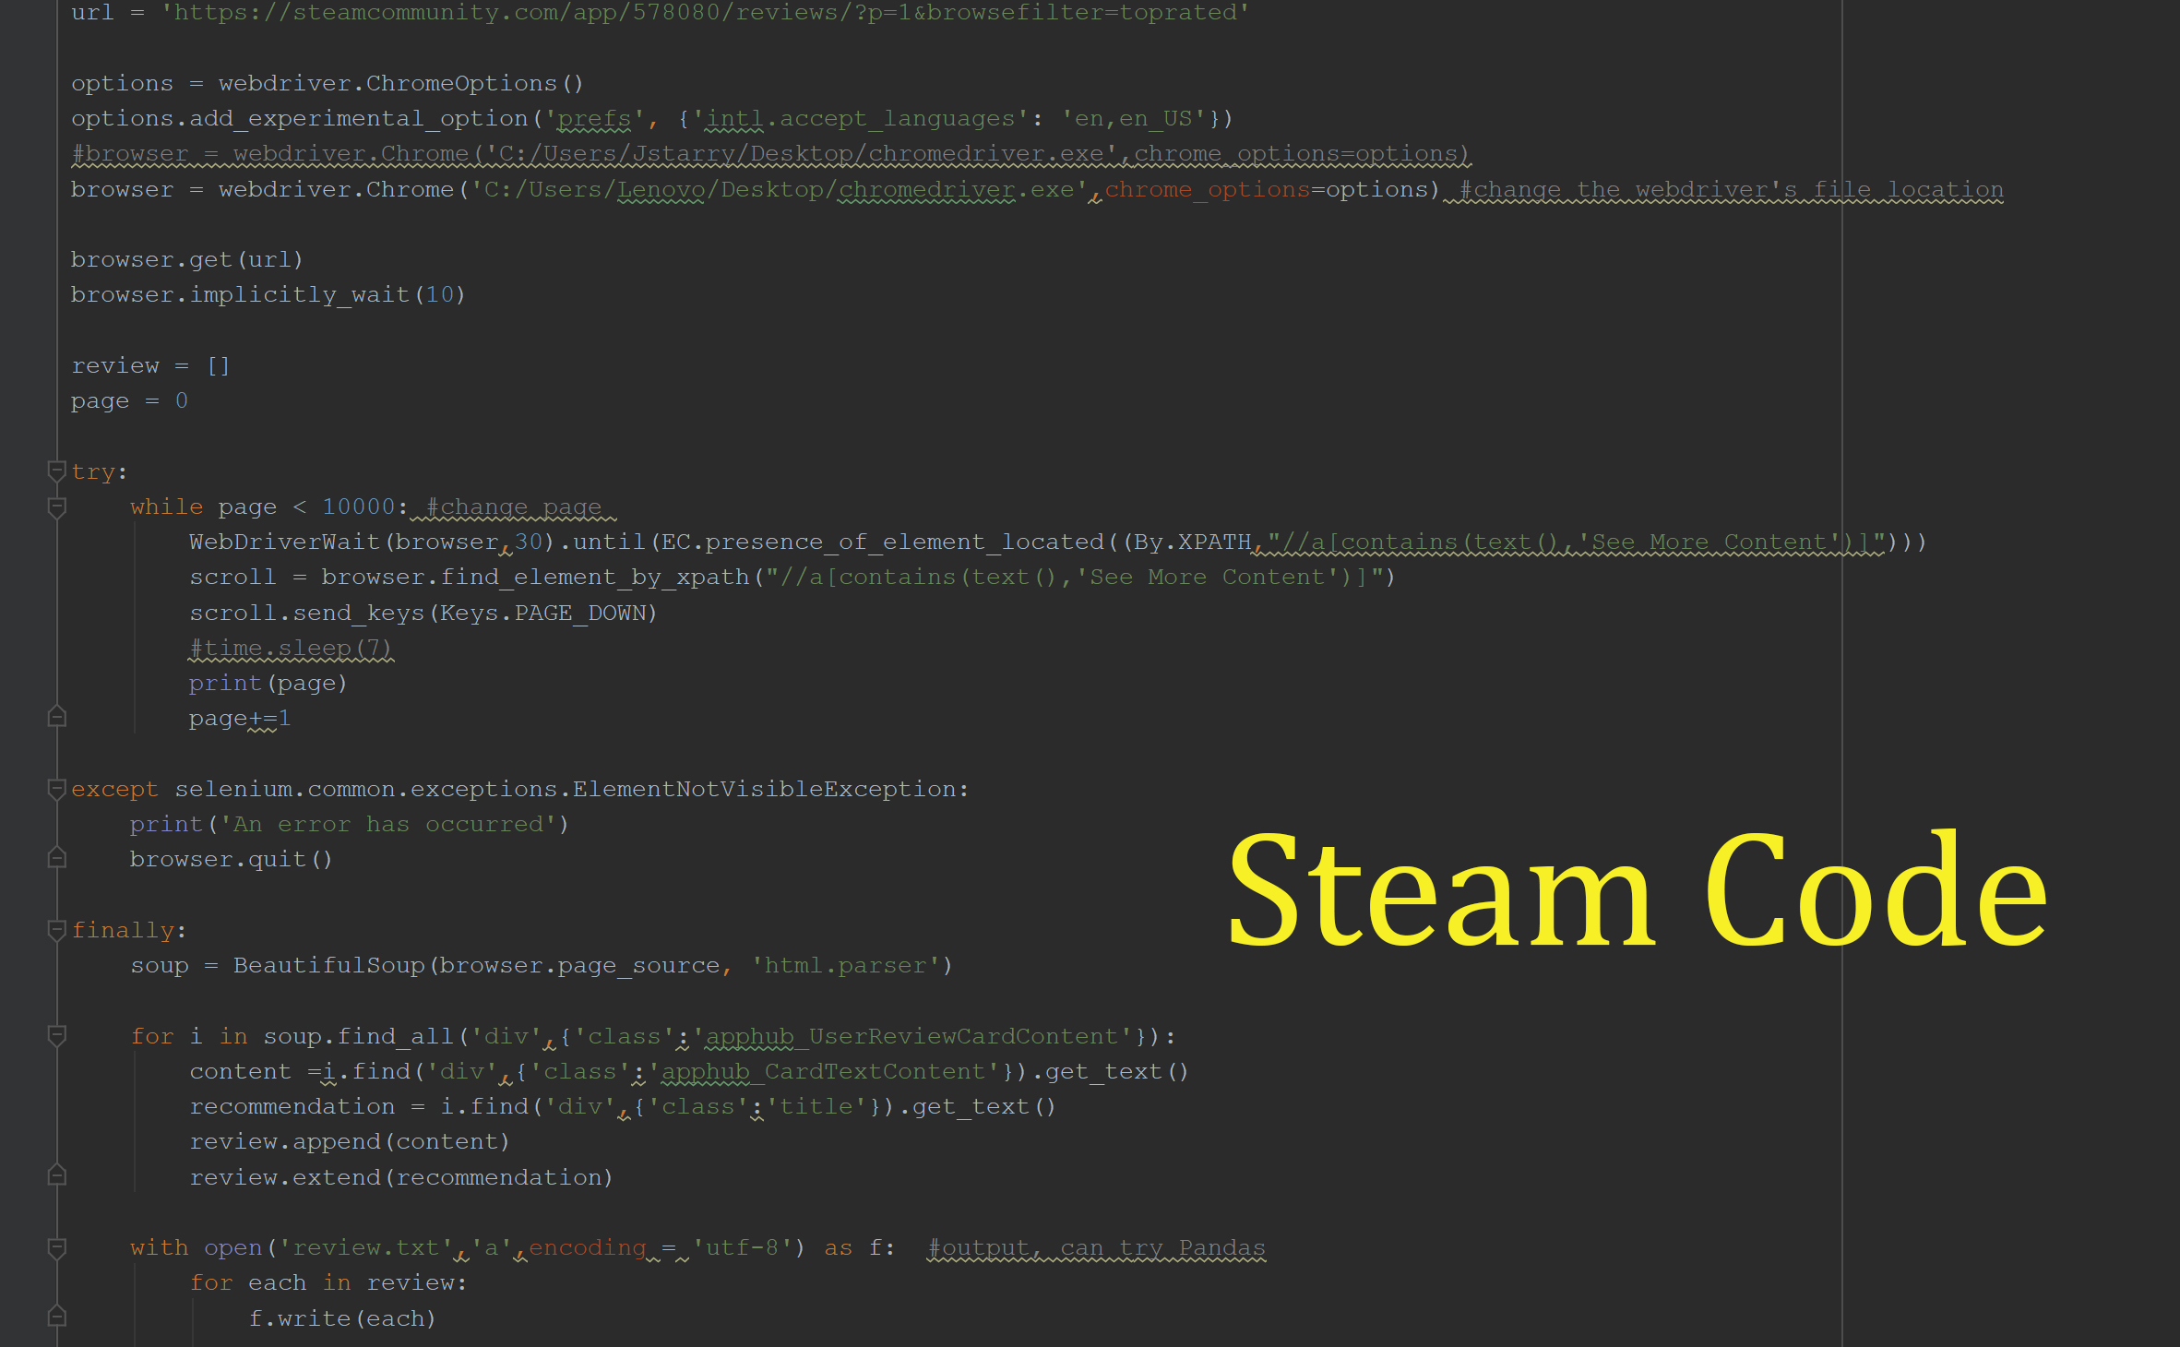
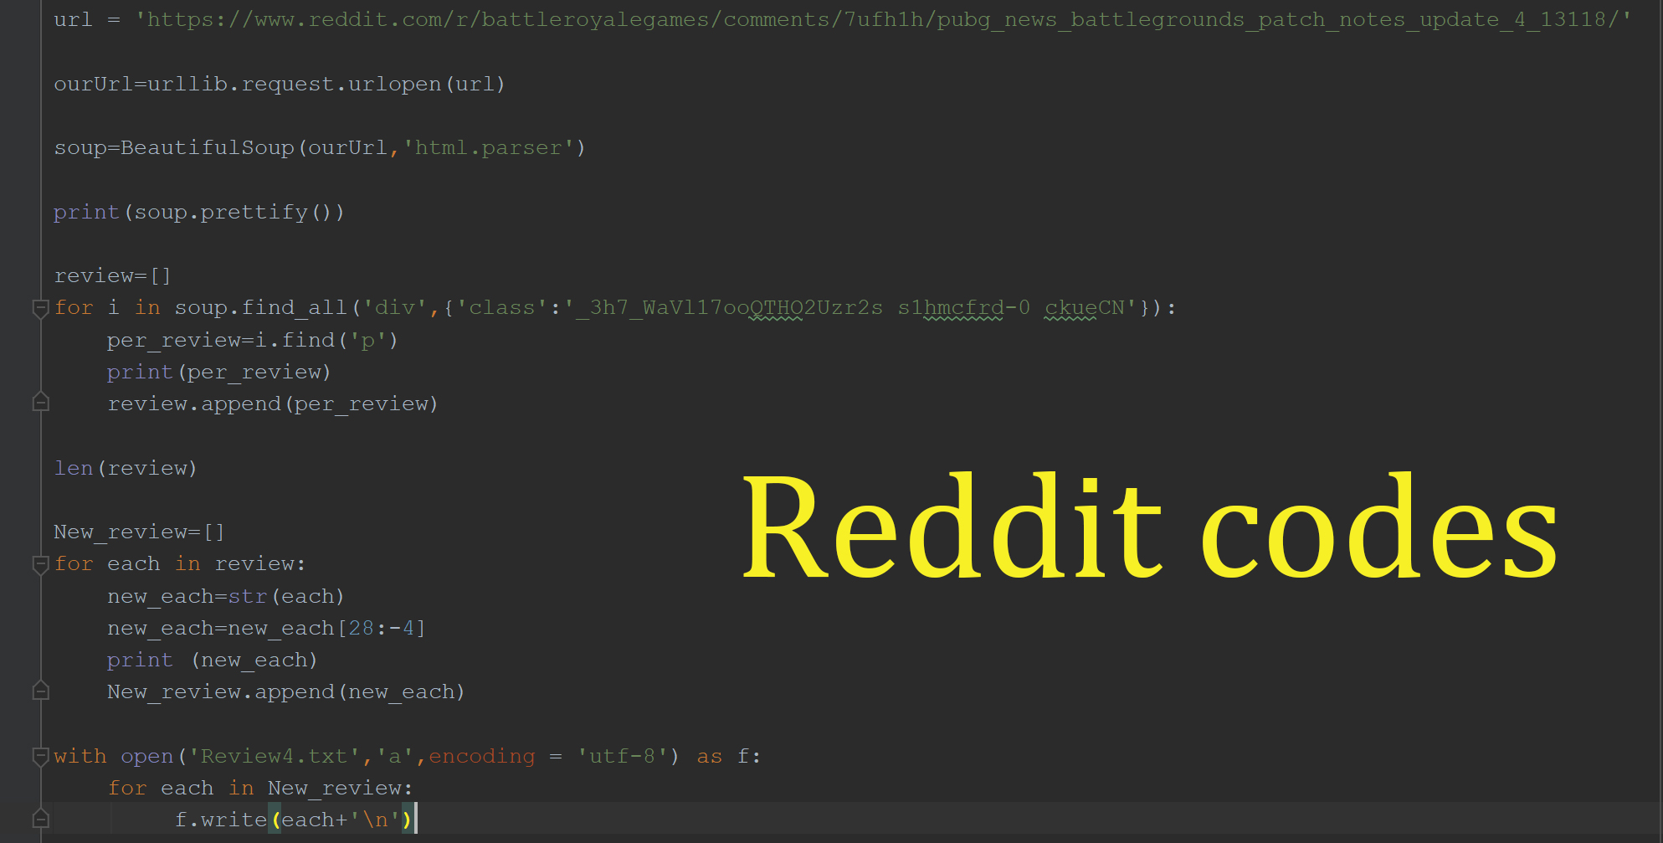
Notes:
Ruiqing

Slide 8
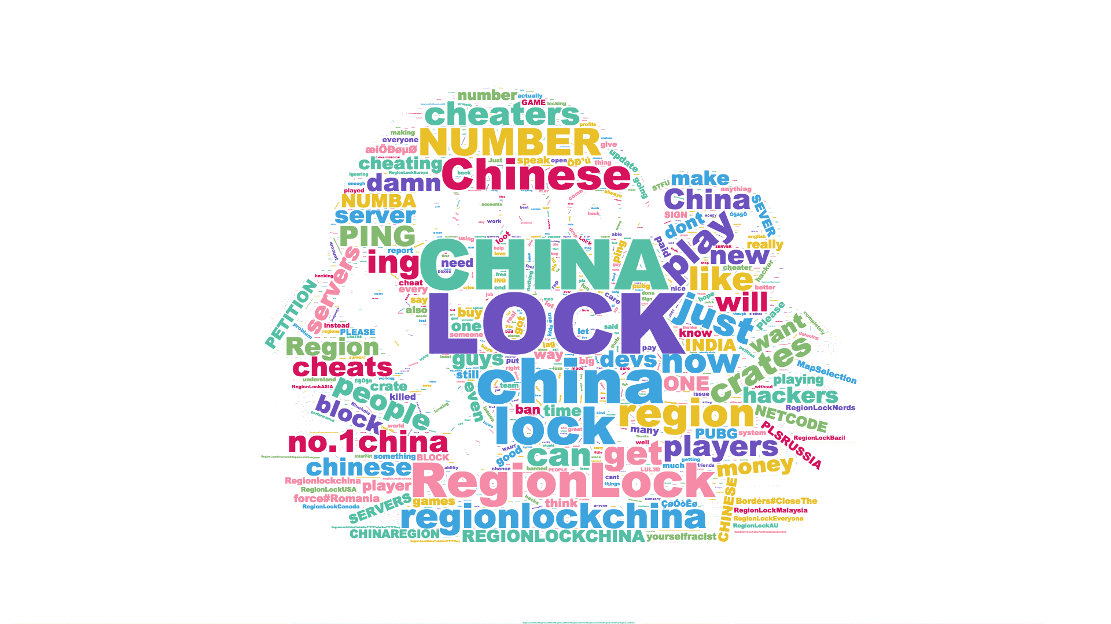
Result: Patch #2

Slide 9
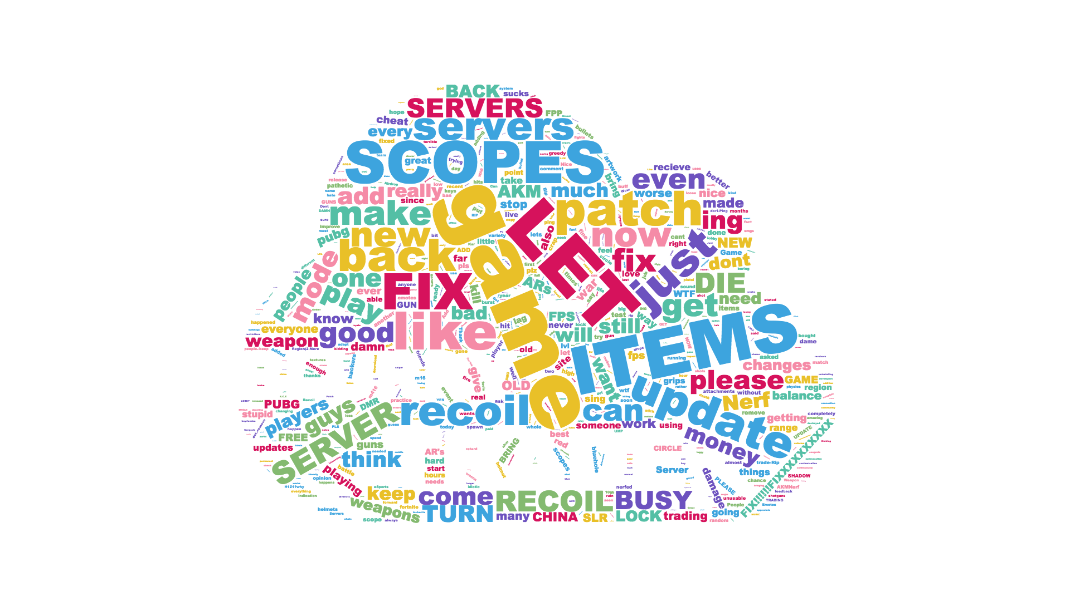
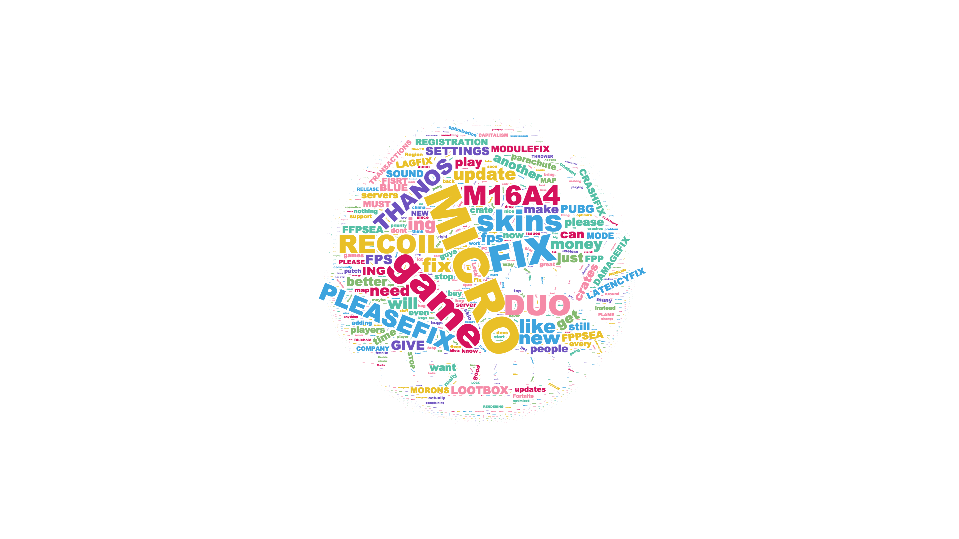
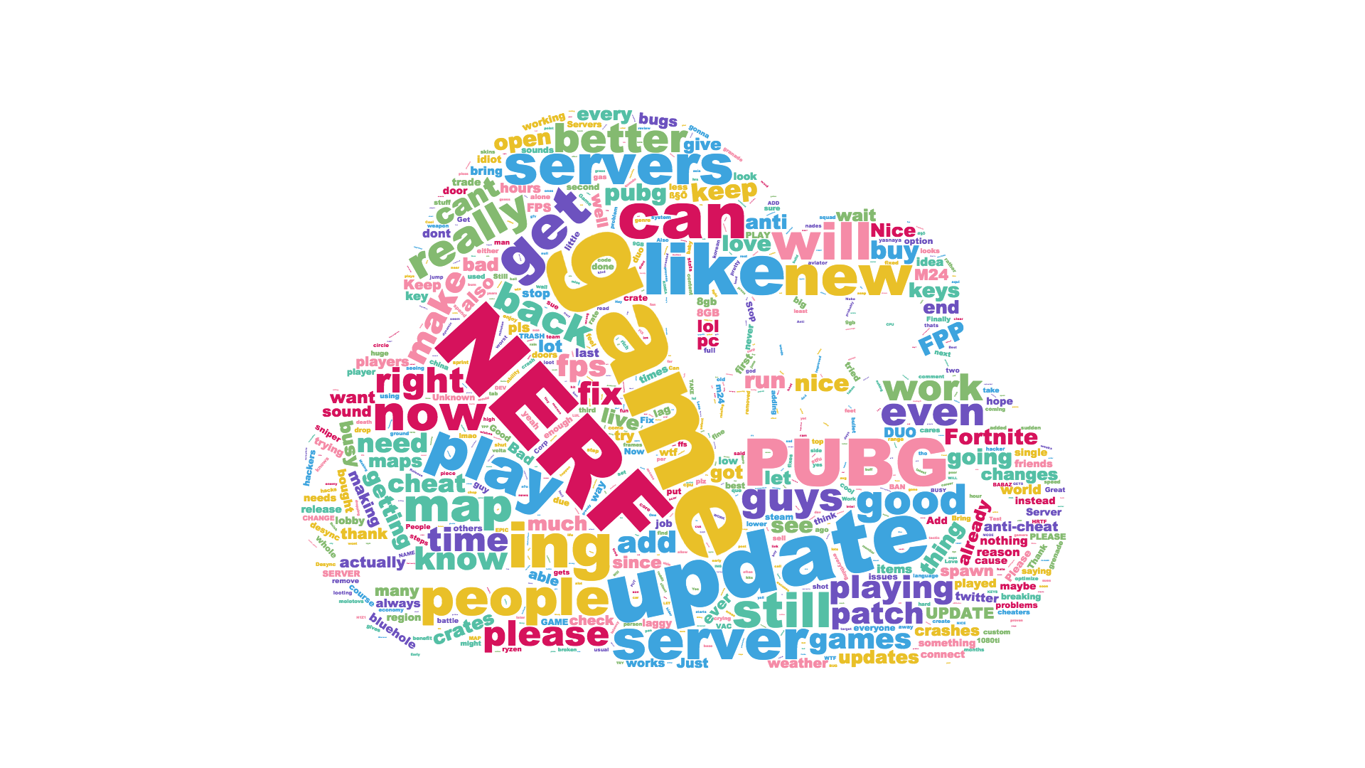
Result: May
Notes:
Ban China
Upgrade anti-hacking software
Fix Bugs
Add Map Selection
Add more microtransaction opportunities

Slide 10
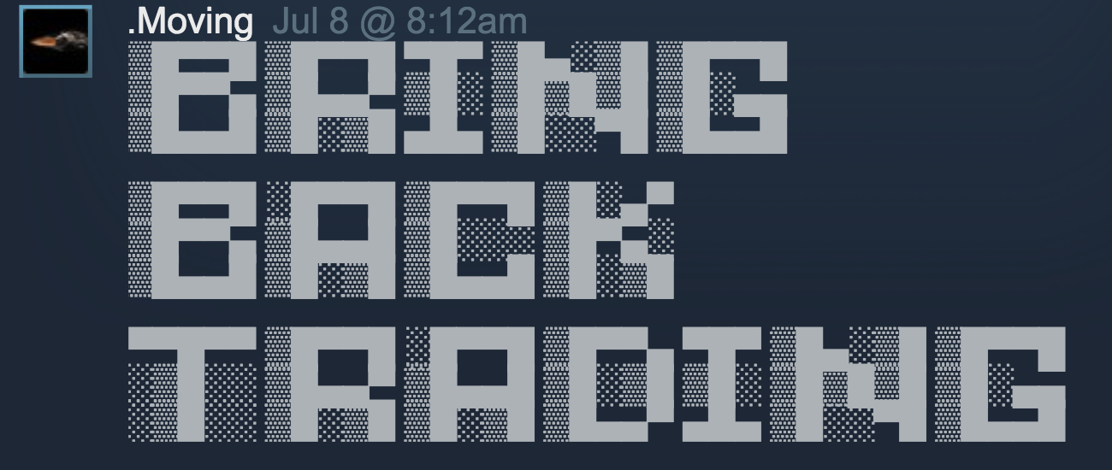
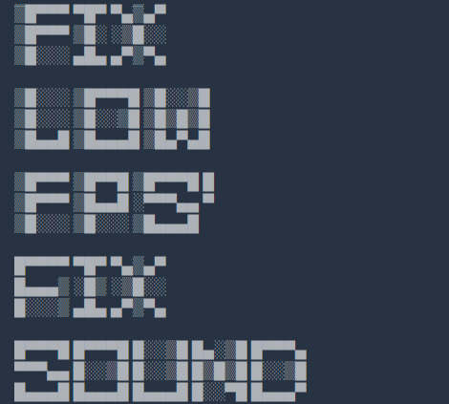
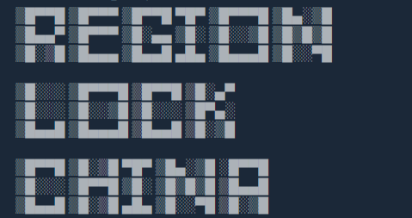

Notes:
Jeke

Slide 11
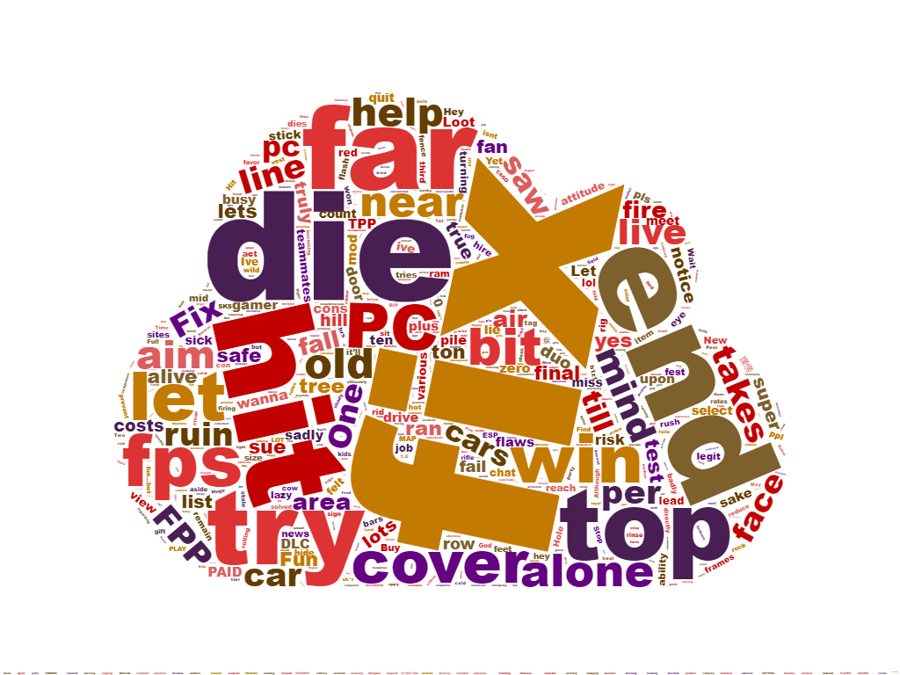
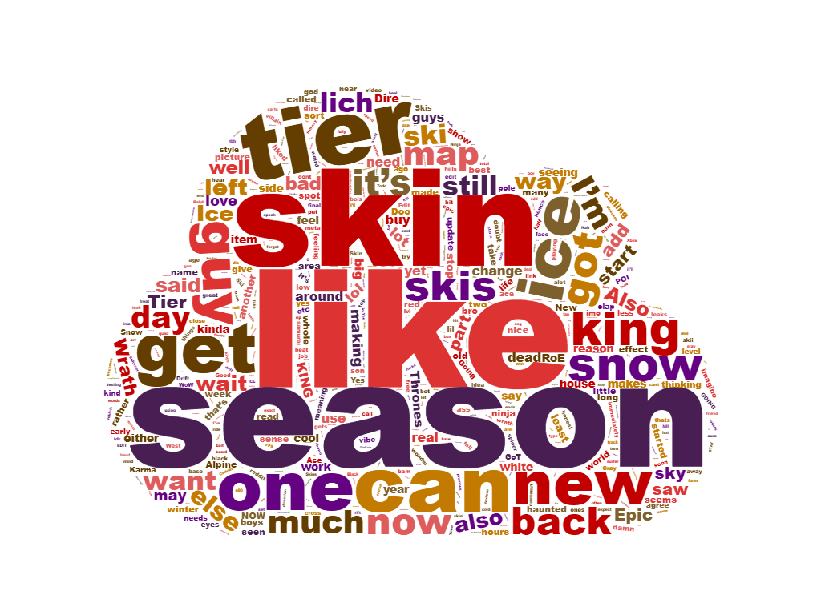
Comparison
 | Fortnite | PUBG
Player base | France, Denmark,Sweden,etc | >50% China
Users | Gain | Drop
Mode | Free and Customized | Pure competition
Patches | 1,180 | 23 updates
Developer | Epic Games | Bluehole

Slide 12
Conclusion / Future Solutions
Fix bugs more often
Region Lock China
Micro-Transactions
Find other factors such Chinese users and personal item trade turning off, and find out if there is any relation between them and user base
Find a way to quantify the reviews that users post that contain images and foreign characters

Slide 13
Questions?

